Slide 1

David M. Kroenke and David J. Auer Database Processing Fundamentals, Design, and Implementation
Appendix I:
Getting Started with Web Servers, PHP and the Eclipse PDT

Slide 2
Appendix Objectives
To install and manage the Microsoft IIS Web server
To understand the file system structure used by IIS
To know how to use the Microsoft Internet Explorer Web browser
To know how to download and store files from Web sites
To know how to download and install the Java Runtime Environment (JRE)
To download, install and use the Eclipse PHP Development Tools (PDT)
To download, install and use PHP

Slide 3
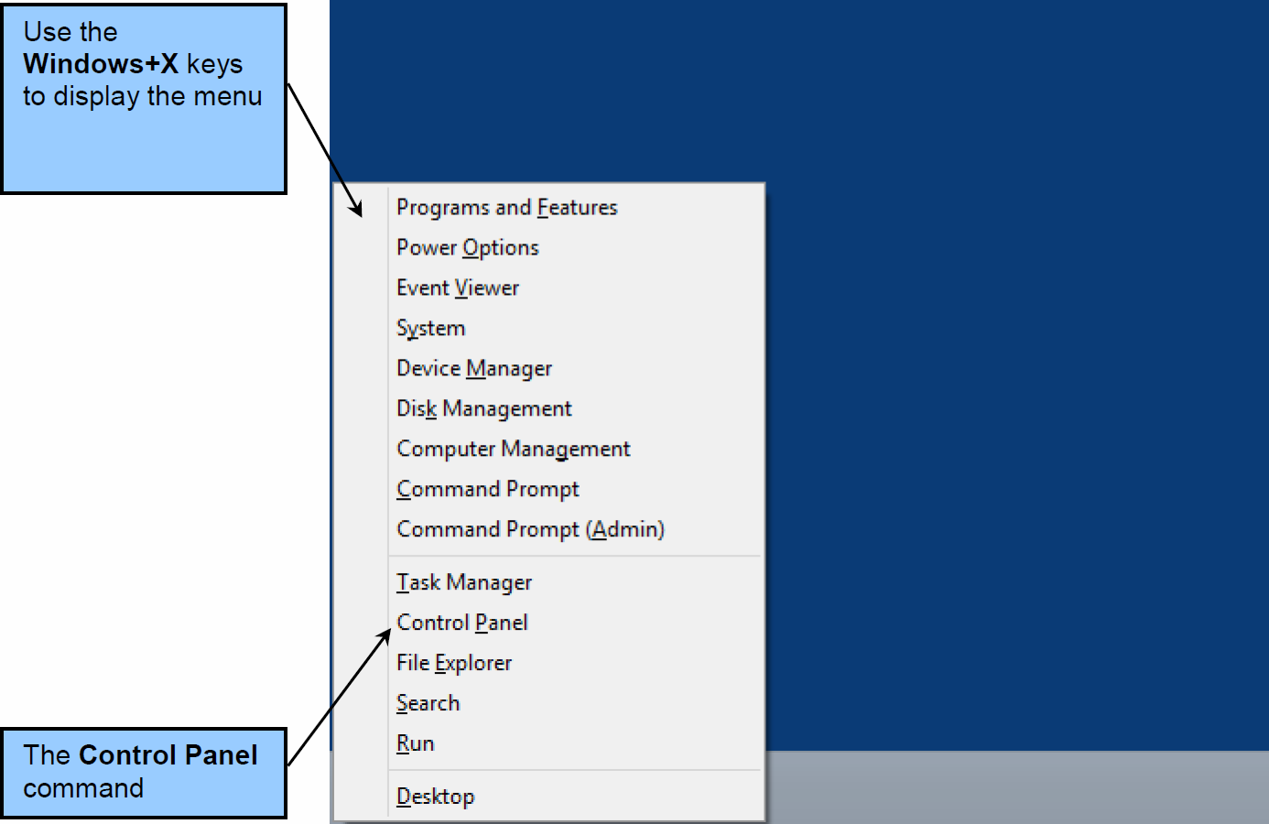
The IIS Web Server Opening Control Panel

Slide 4
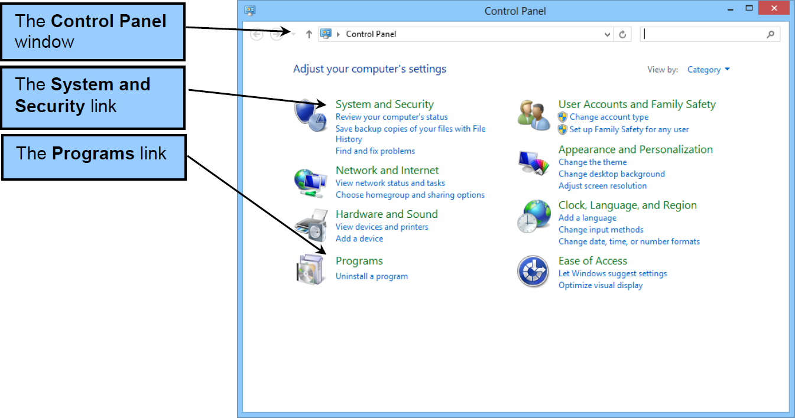
The IIS Web Server The Control Panel Window

Slide 5
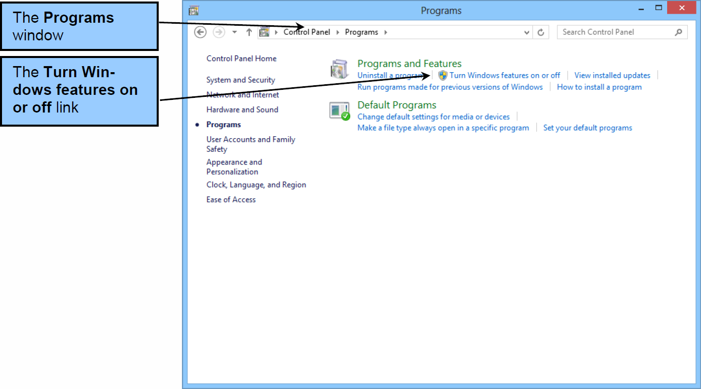
The IIS Web Server The Programs Window

Slide 6
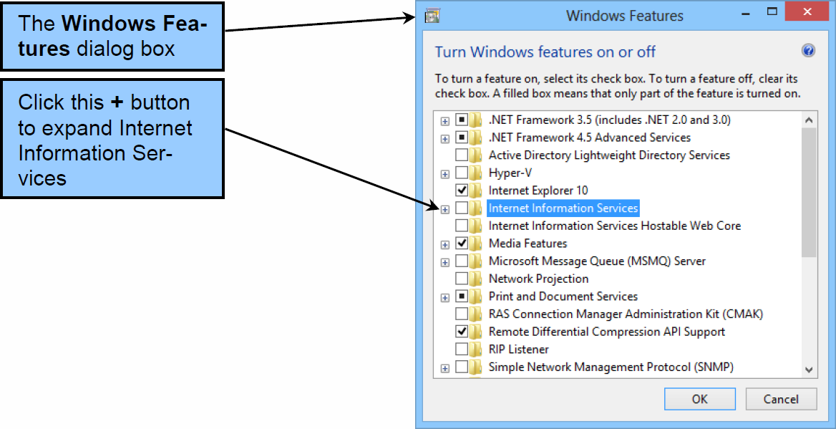
The IIS Web Server The Windows Features Dialog Box

Slide 7
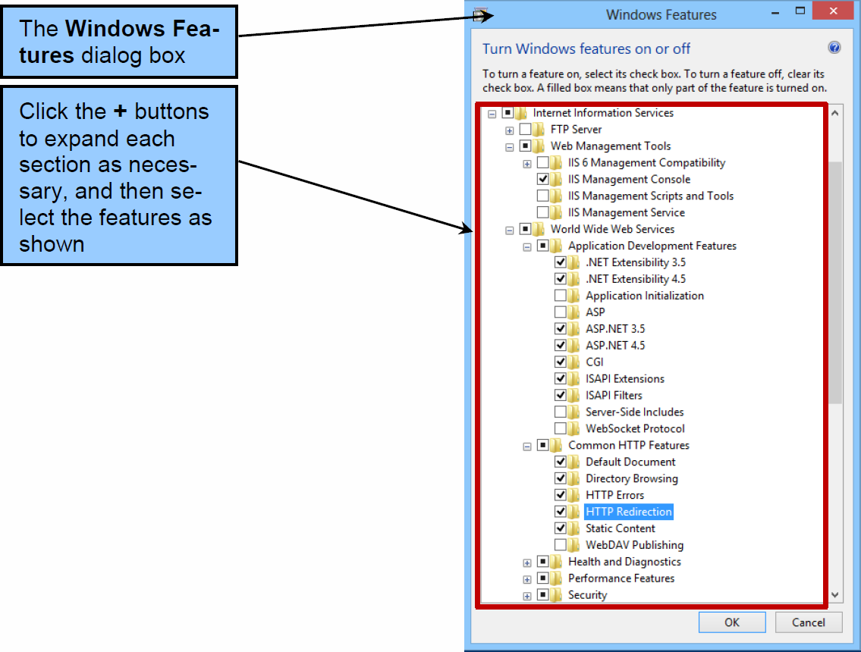
The IIS Web Server The Selected Internet Information Services Features

Slide 8
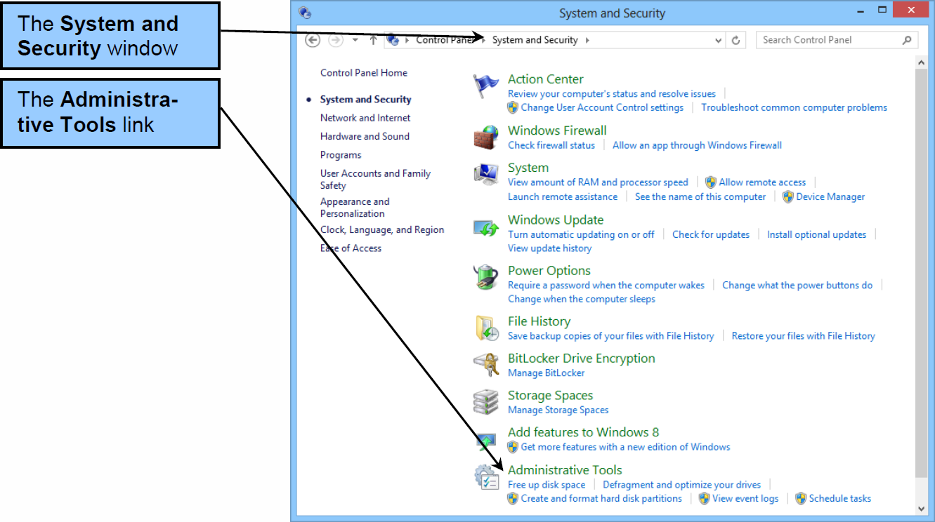
The Internet Information Service (IIS) Manager The Administrative Tools Window

Slide 9
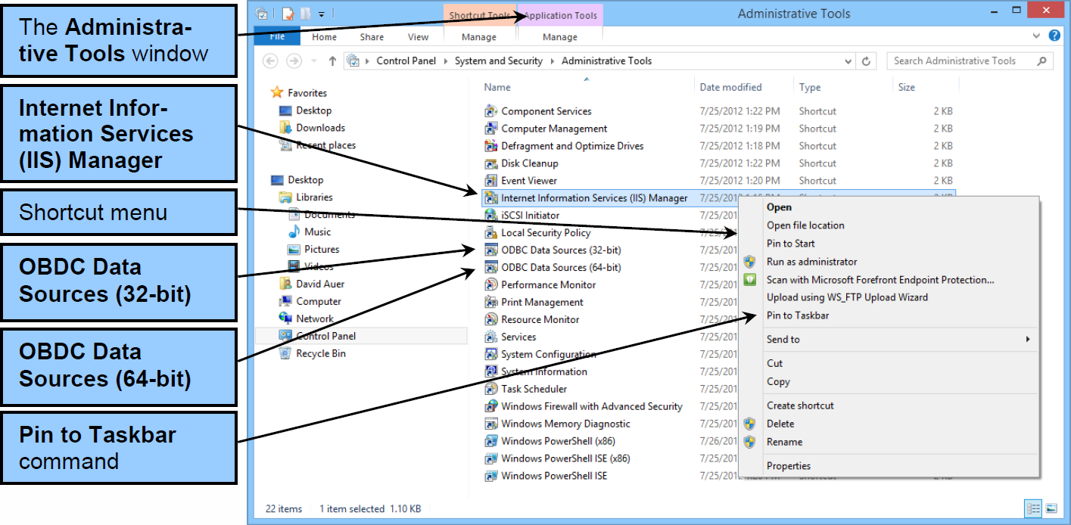
The Internet Information Service (IIS) Manager The Short-cut Menu

Slide 10
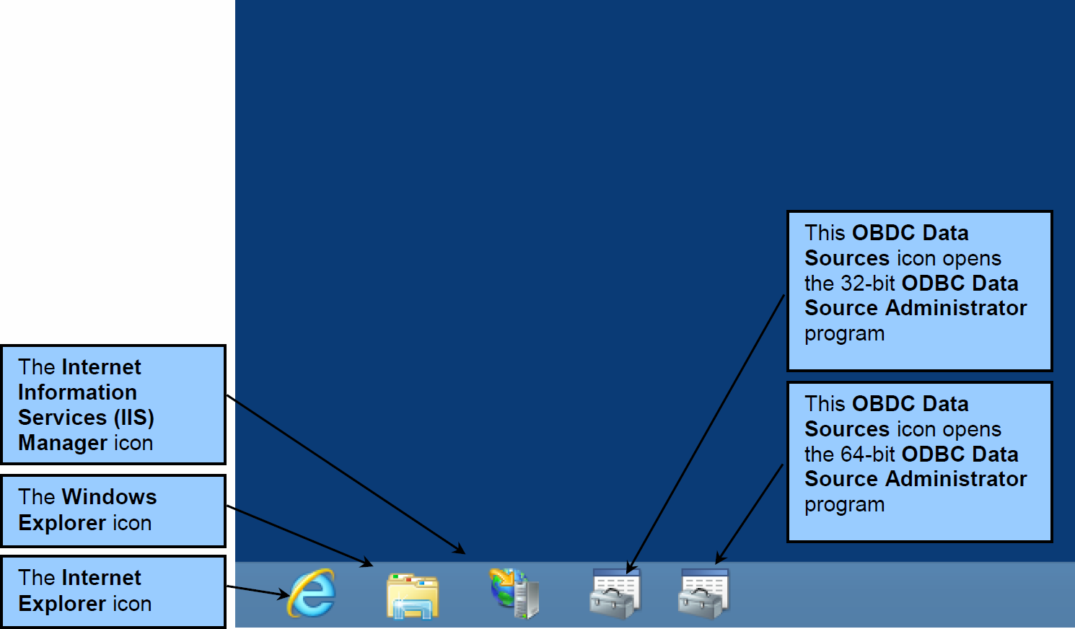
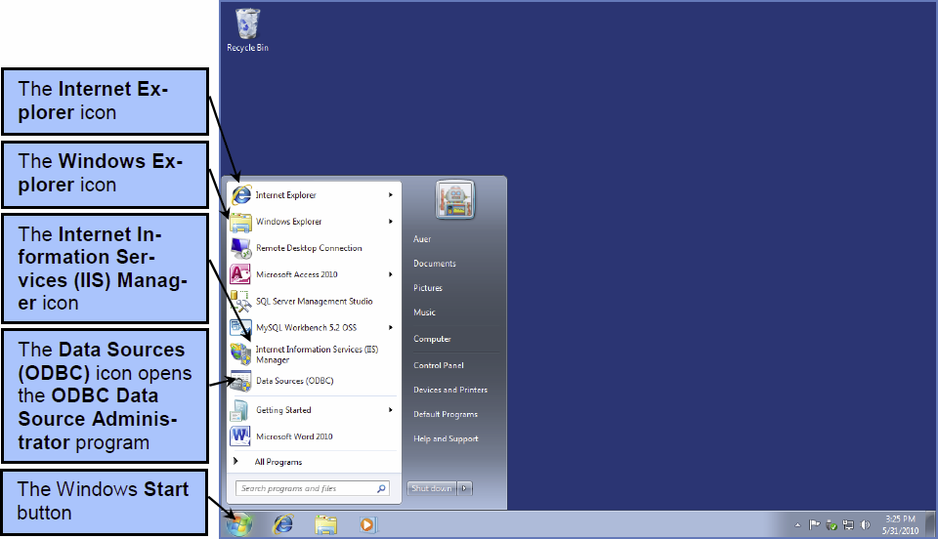
The Internet Information Service (IIS) Manager The New Program Icons in Windows 8

Slide 11
32-Bit versus 64-Bit ODBC I
The ODBC Data Sources program we have been using is for the 64-bit version of the ODBC data sources administration program, and will create 64-bit ODBC data sources.
These will only work as long as every component in the Web application program chain is a 64-bit program. But, if any component is a 32-bit program, the 64-bit ODBC data source will not work.

Slide 12
32-Bit versus 64-Bit ODBC II
In fact, when you are building the Web database applications in this chapter, if everything seems to be correctly done but the system still does not work, the most likely cause is a 32-bit program in the chain.
If you are running the Windows 7 operating system, to resolve this problem you will need to use the 32-bit version of the ODBC Data Sources program located at C:\Windows\SysWOW64\odbcad32.exe.
Window 8, fortunately, make both programs available in Application Tools.

Slide 13
32-Bit versus 64-Bit ODBC III
To resolve your Web database application problem, create a 32-bit ODBC data source using OBDC Administrator, and then revise your Web page code to use that ODBC data source.
For more information on the programs in the Windows\SysWOW64 folder, see the Wikipedia article on WoW64 at http:// en.wikipedia.org/wiki/WoW64.

Slide 14
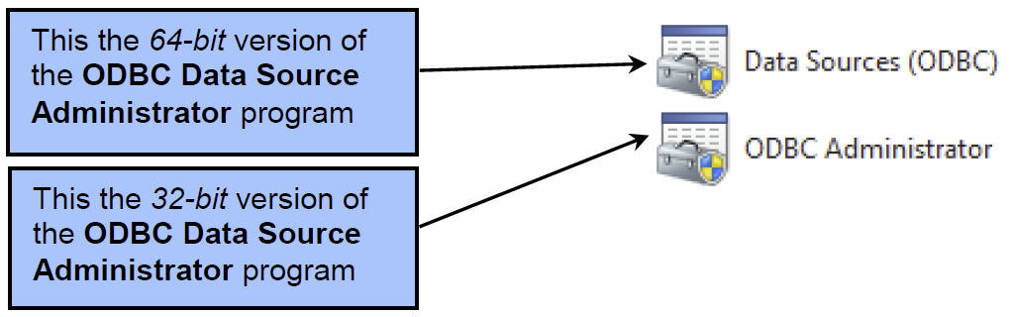
32-Bit versus 64-Bit ODBC IV
In Windows 7, the two icons for the two versions appear as shown below. Note that although the program icons are the same, the program names are different. Data Source (OBDC ) is the 64-bit version, and OBDC Administrator is the 32-bit version.

Slide 15
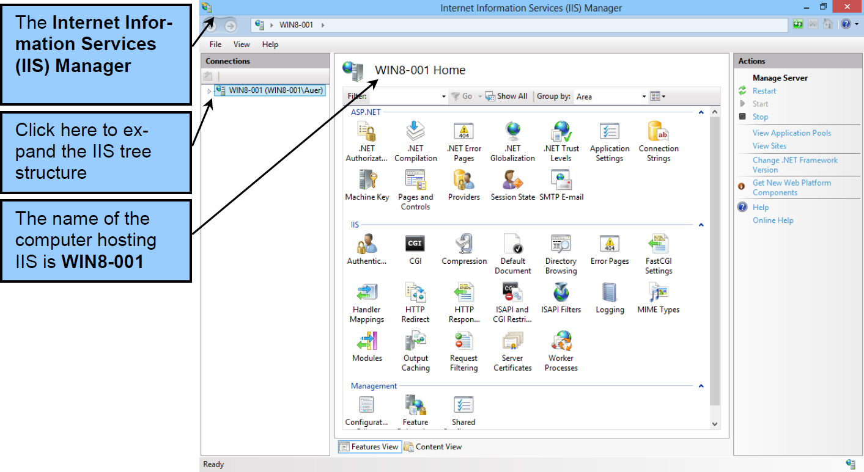
The Internet Information Service (IIS) Manager The IIS Manager Itself

Slide 16
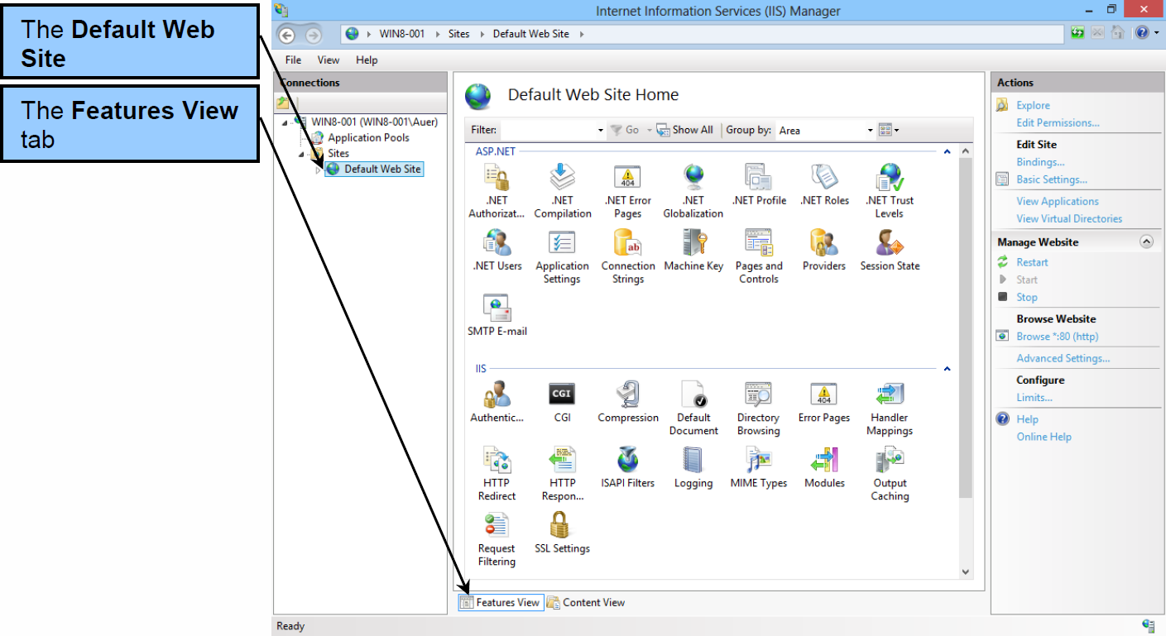
The Internet Information Service (IIS) Manager The Default Web Site

Slide 17
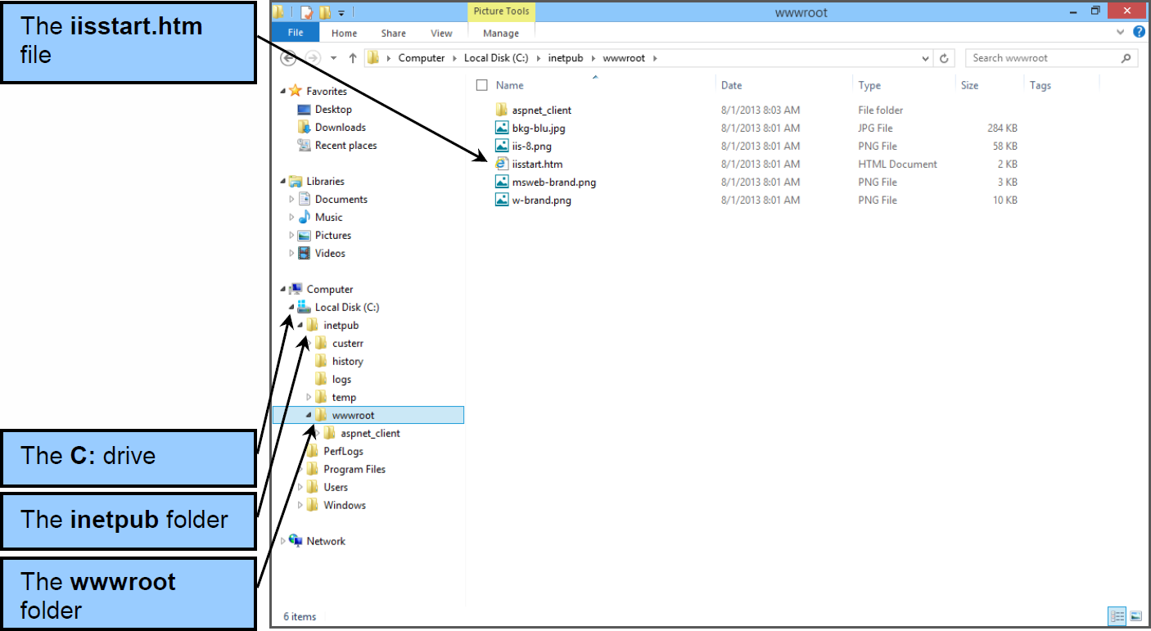
The Internet Information Service (IIS) Manager The IIS inetpub Directory Structure and the wwwroot Folder

Slide 18
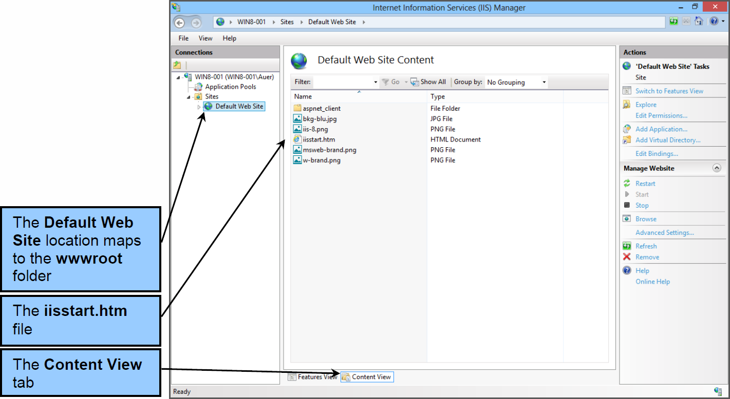
The Internet Information Service (IIS) Manager The Default Web Site Maps to the wwwroot Folder

Slide 19
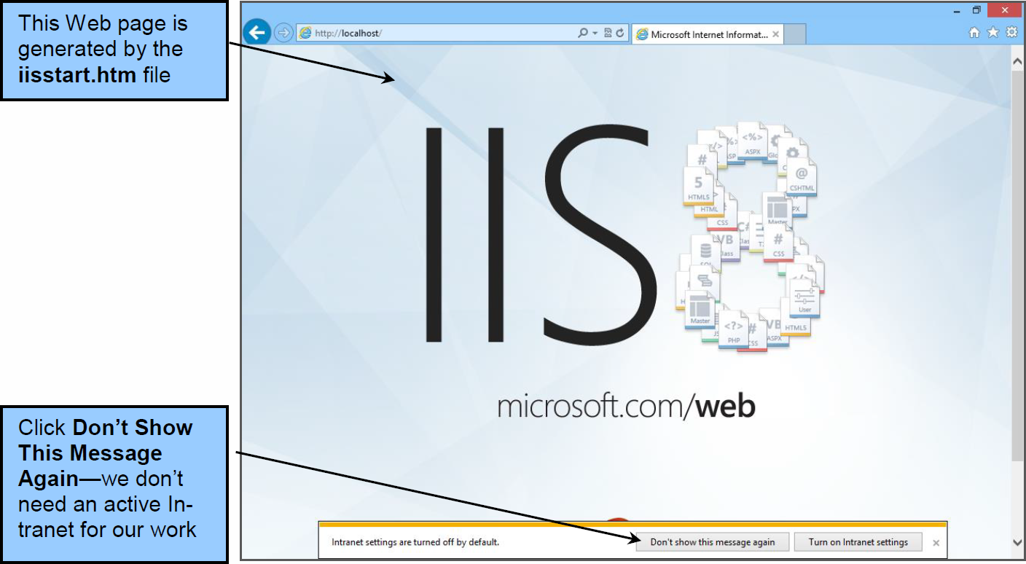
The Internet Information Service (IIS) Manager The Default Web Site in the Web Broswer

Slide 20
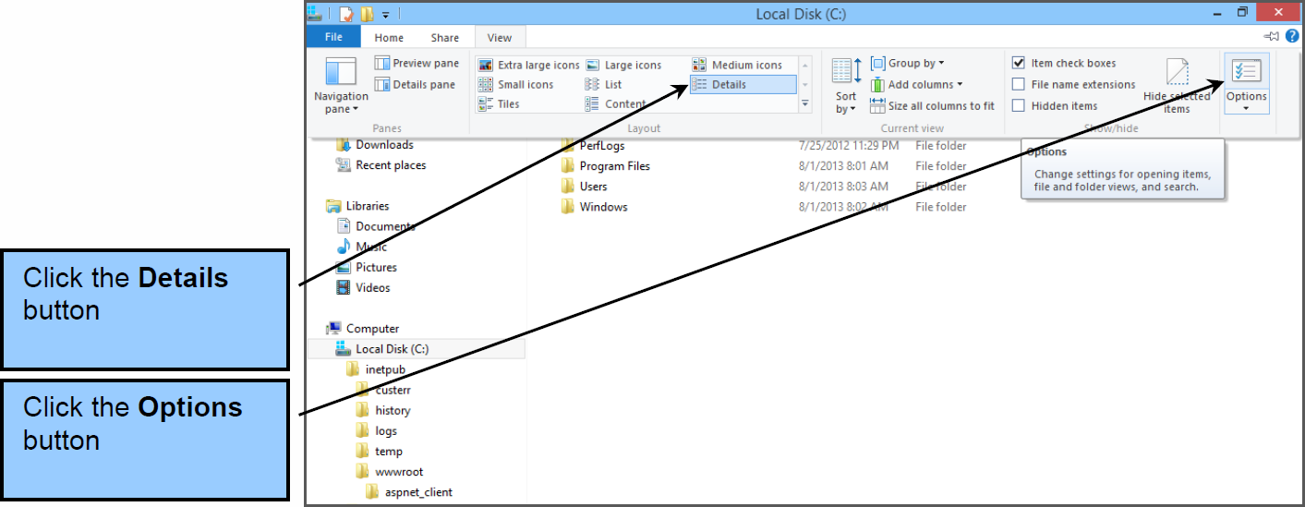
Web Site Security Management The Folder and Search Options Command

Slide 21
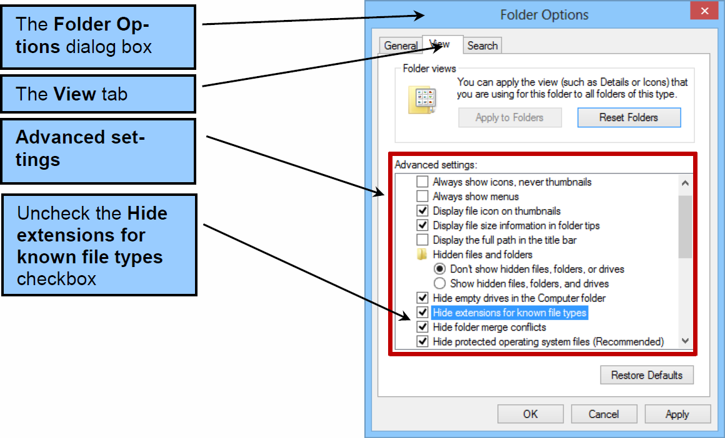
Web Site Security Management The View Page in the Folder Options Dialog Box

Slide 22
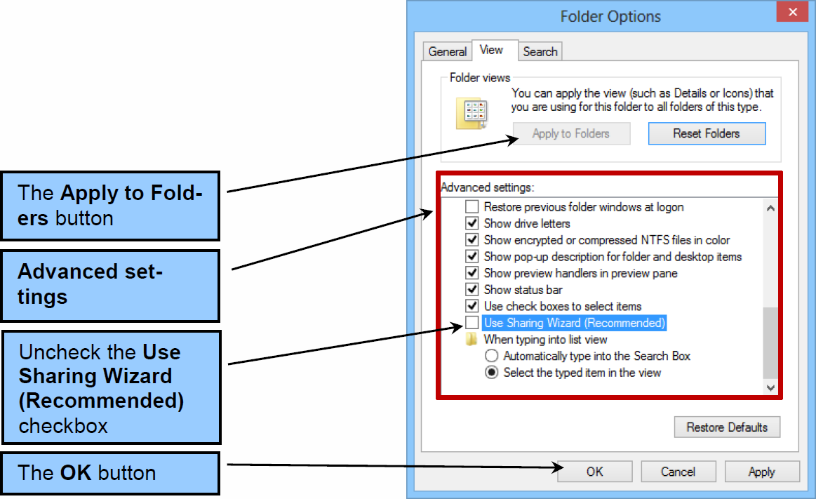
Web Site Security Management The Use Sharing Wizard (Recommended) Setting

Slide 23
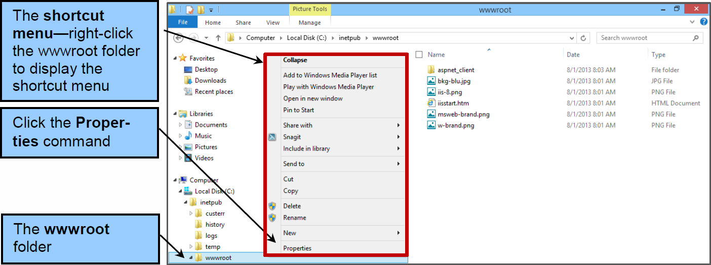
Web Site Security Management The Properties Command

Slide 24
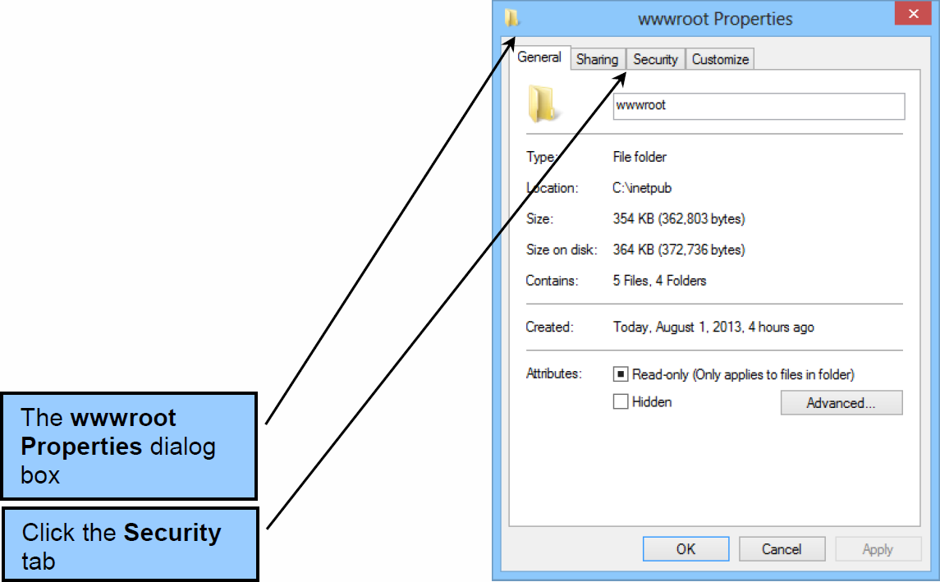
Web Site Security Management The wwwroot Properties Dialog Box

Slide 25
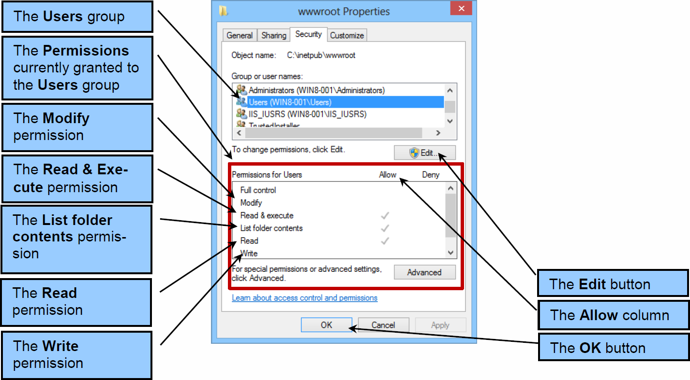
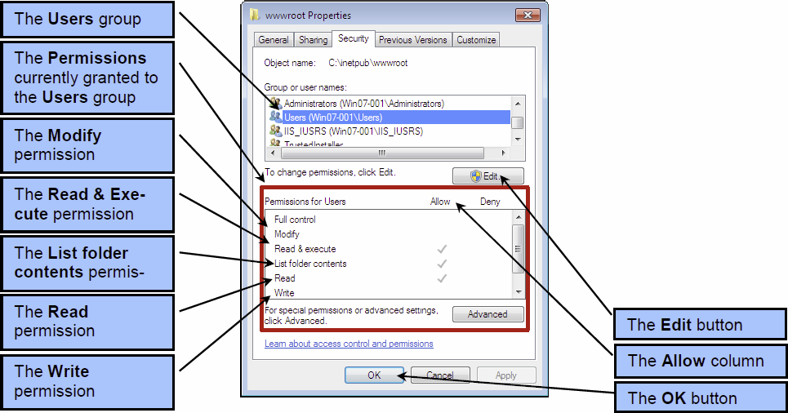
Web Site Security Management The Users Group Permissions

Slide 26
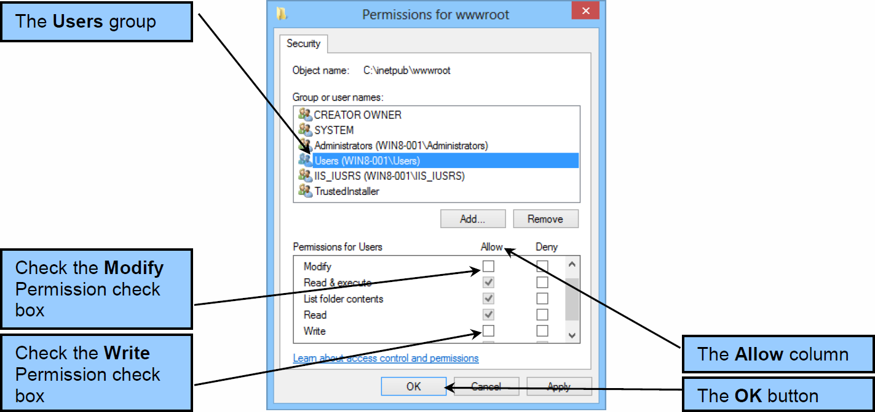
Web Site Security Management Editing the Users Group Permissions

Slide 27
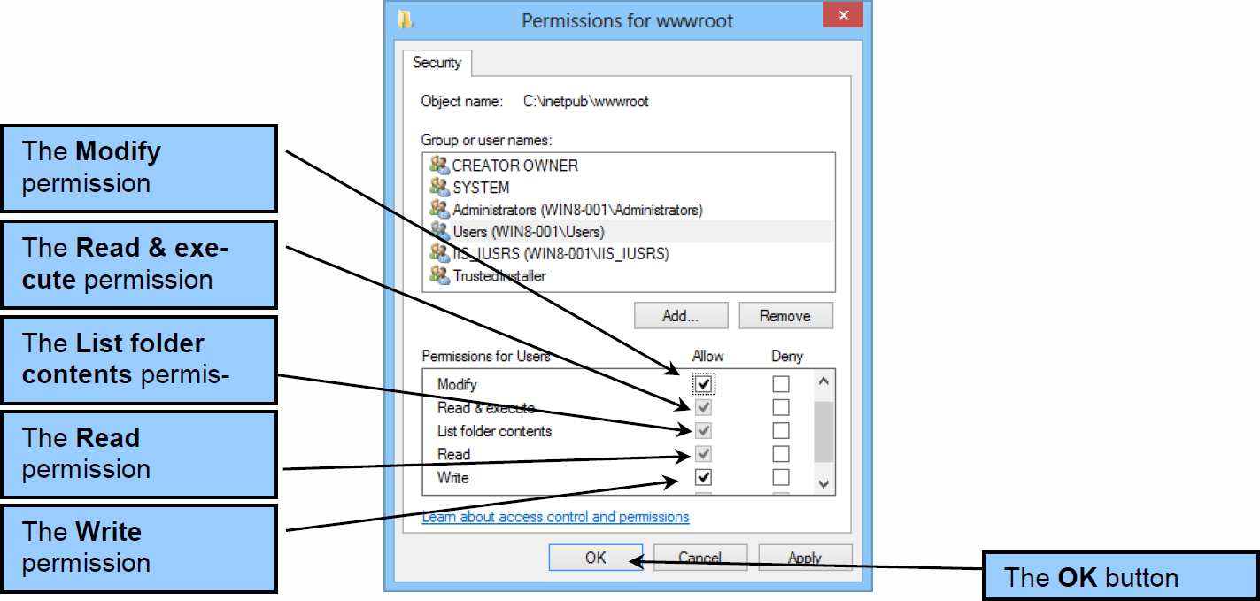
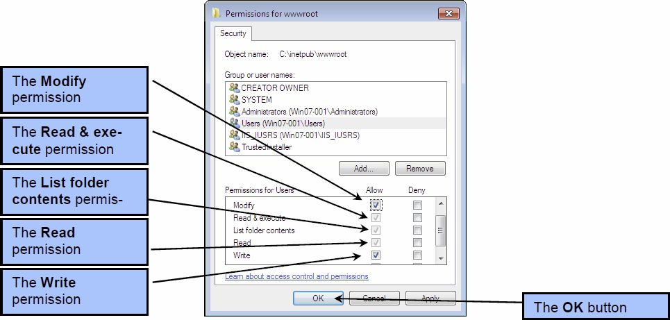
Web Site Security Management The Final Users Group Permissions

Slide 28
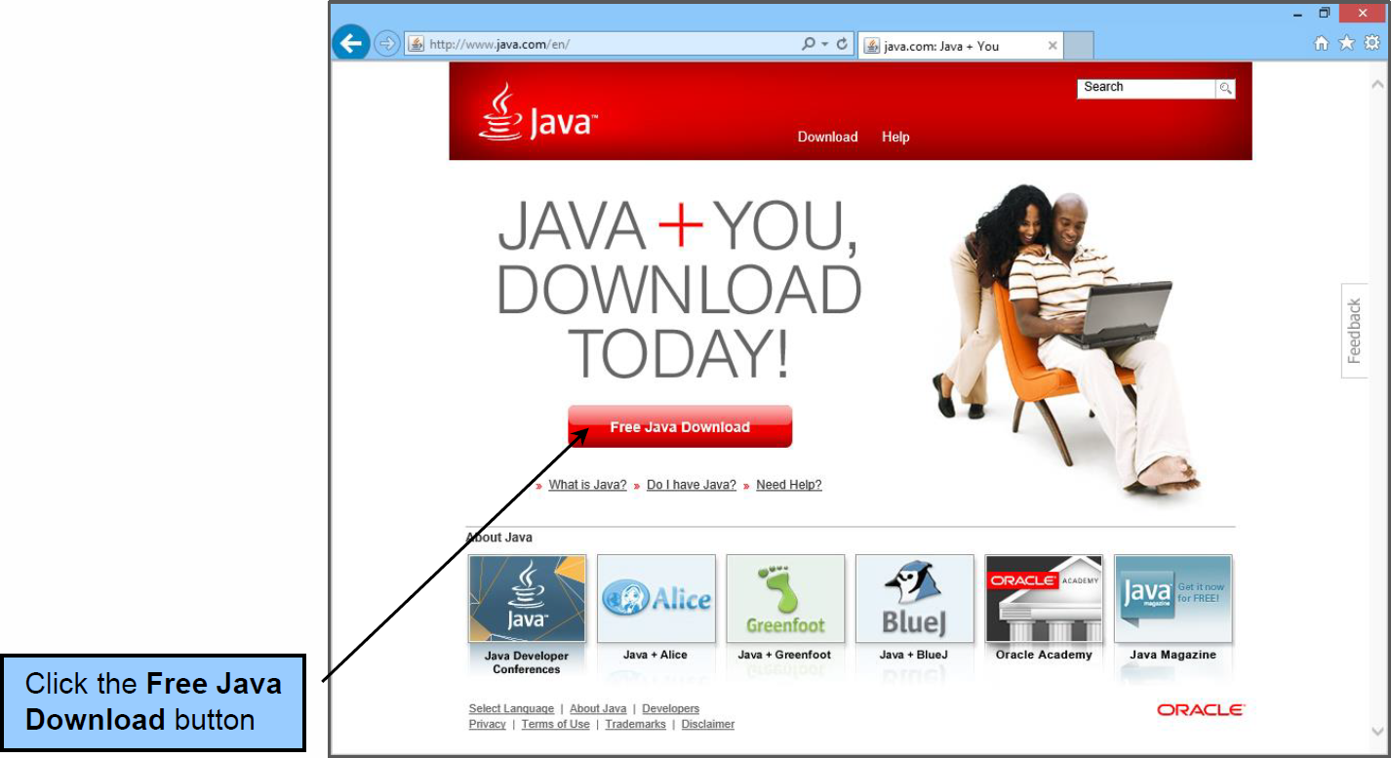
Installing the Java Runtime Environment (JRE) The Java JRE Web Page

Slide 29
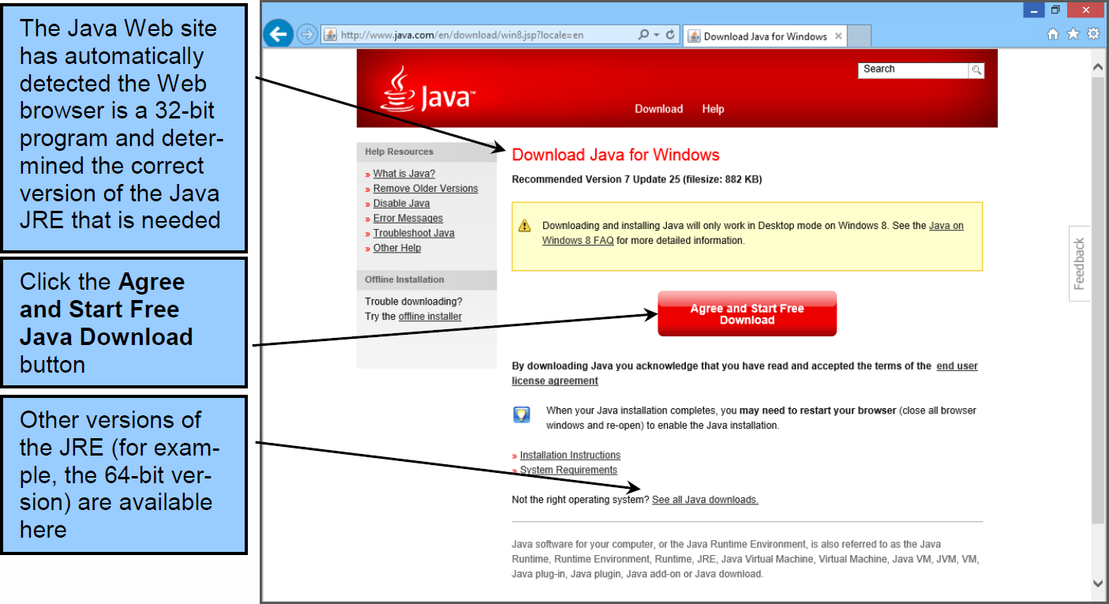
Installing the Java Runtime Environment (JRE) The Java Web Site Determines the Correct Version of the Java JRE

Slide 30
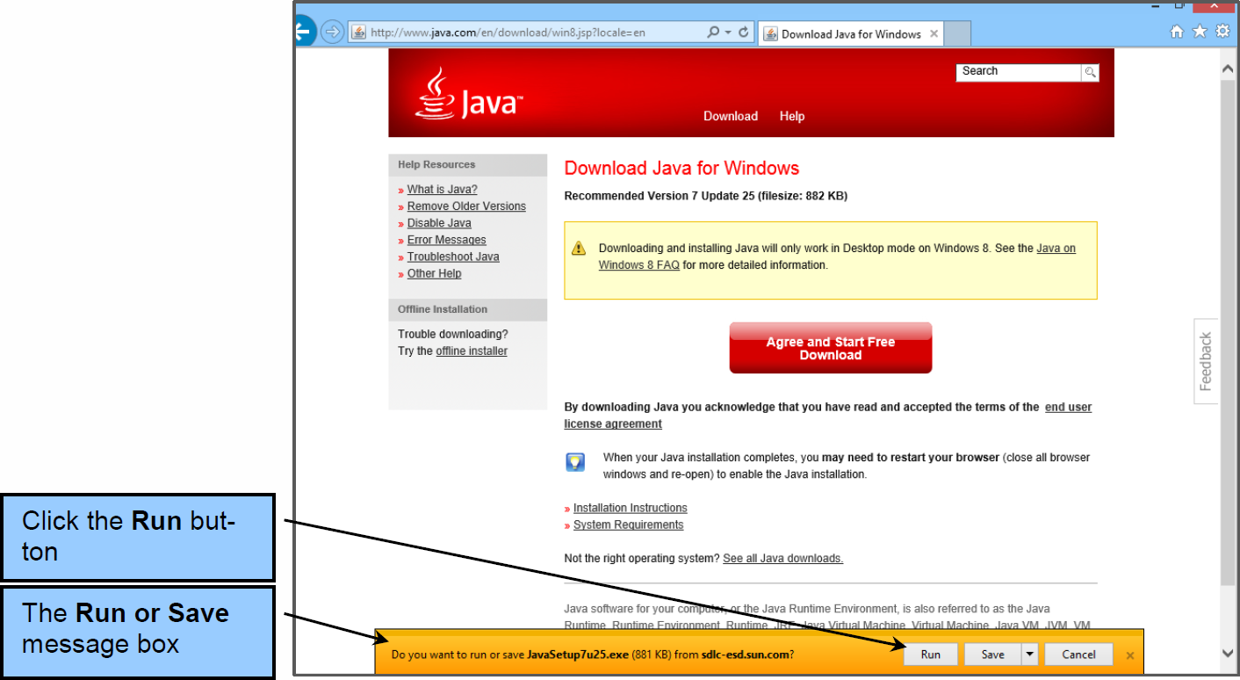
Installing the Java Runtime Environment (JRE) The Do You Want to Run or Save {Filename} Message Box

Slide 31
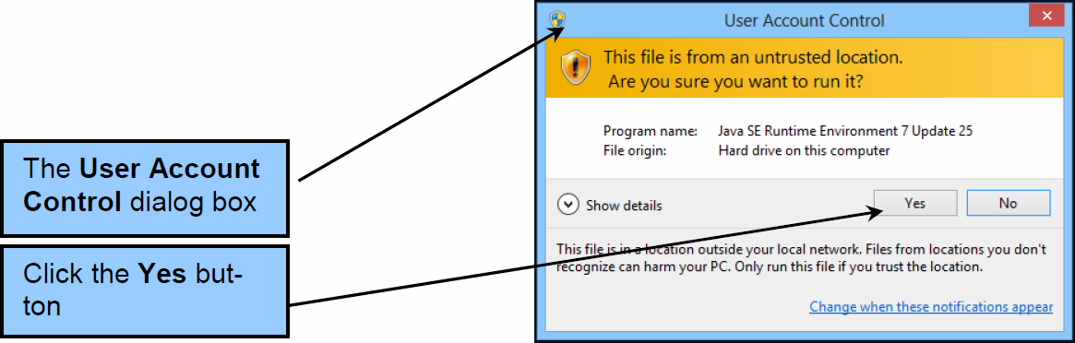
Installing the Java Runtime Environment (JRE) The User Account Control Dialog Box

Slide 32
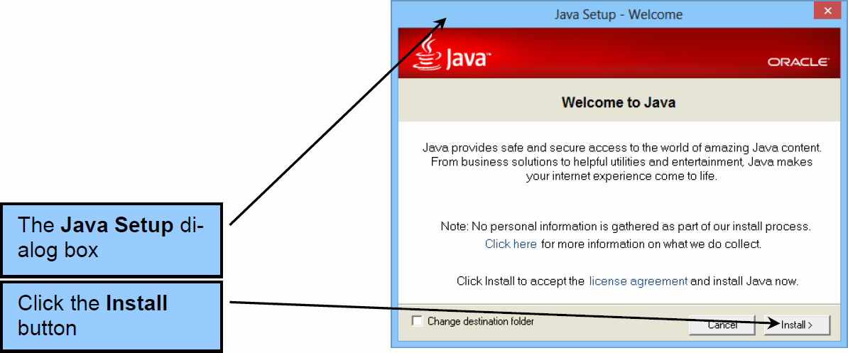
Installing the Java Runtime Environment (JRE) The Java Setup Dialog Box Welcome Page

Slide 33
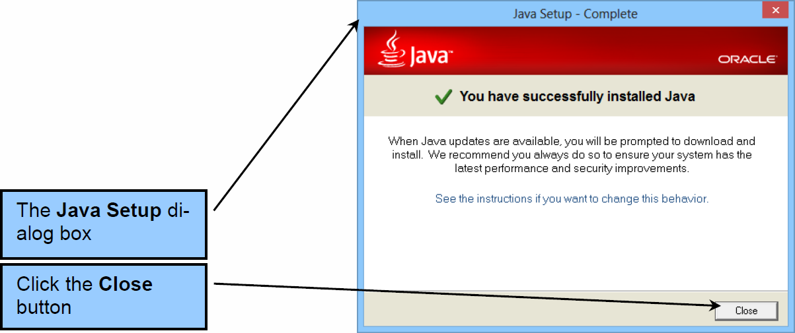
Installing the Java Runtime Environment (JRE) The Java Setup Dialog Box Complete Page

Slide 34
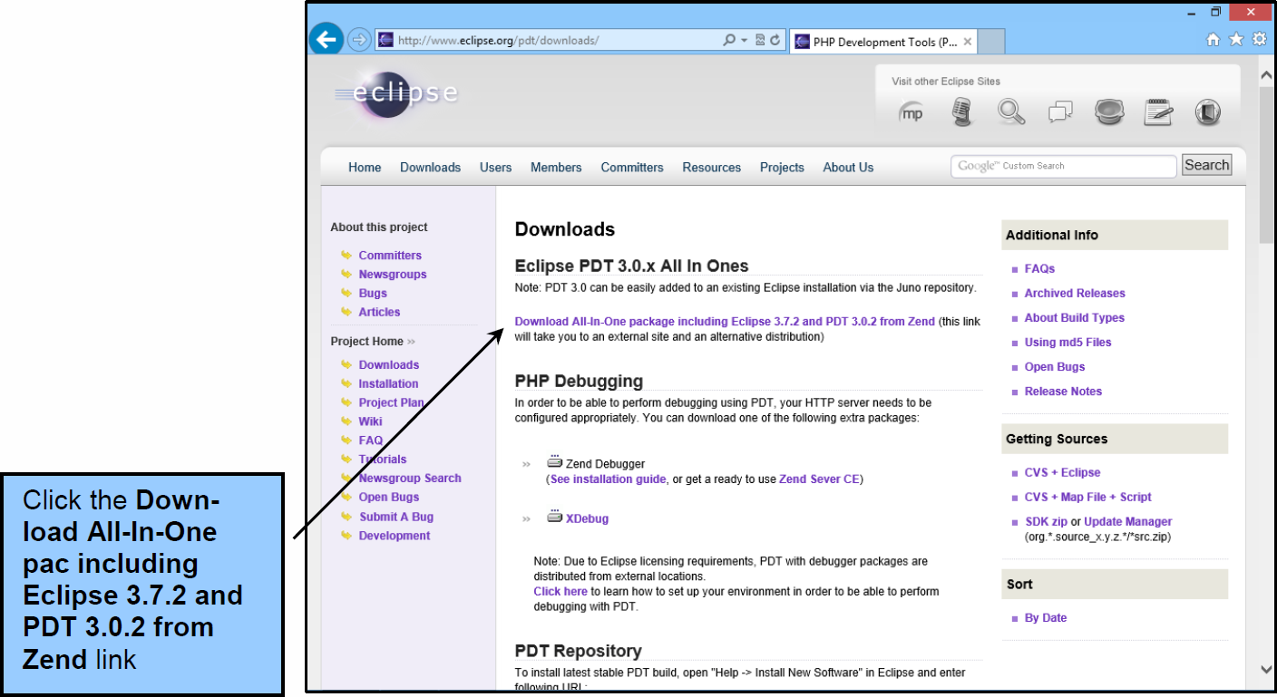
Installing the Eclipse PDT The PDT All In One / Eclipse PHP Packages

Slide 35
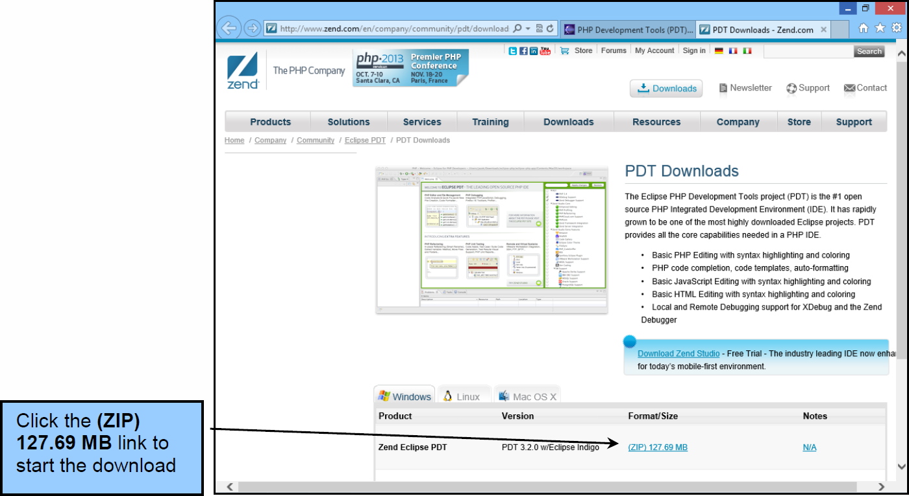
Installing the Eclipse PDT The Eclipse Downloads – Mirror Selection Web Page

Slide 36
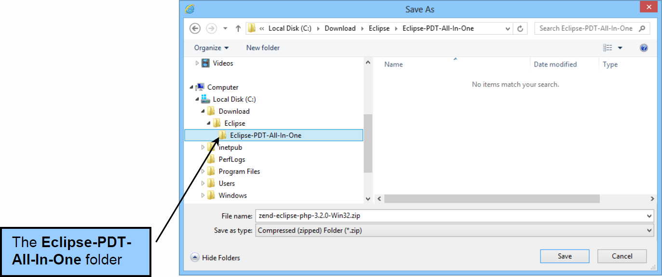
Installing the Eclipse PDT The C:\Download\Eclipse\Eclipse-PDT-All-In-One Folder

Slide 37
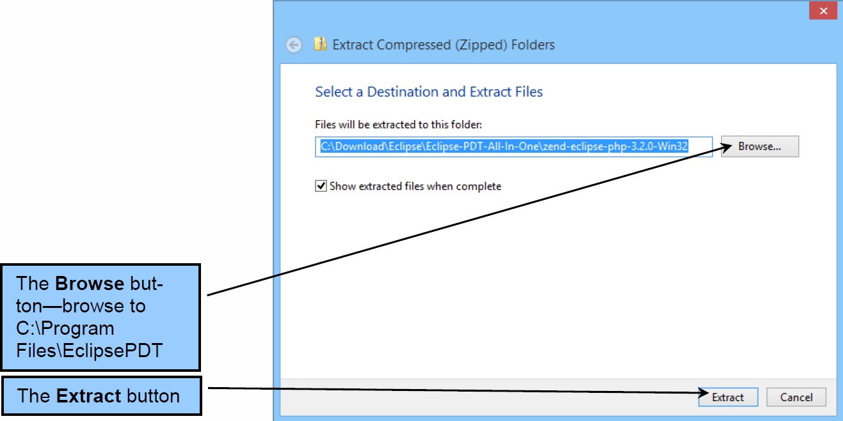
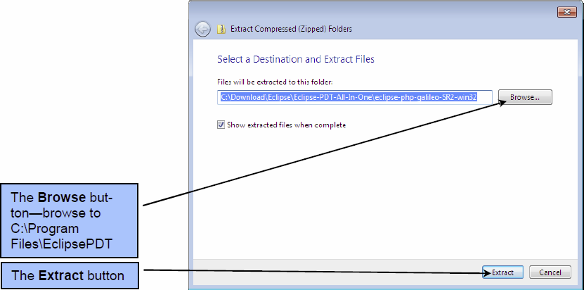
Installing the Eclipse PDT The Extract Compressed (Zipped) Folders Dialog Box

Slide 38
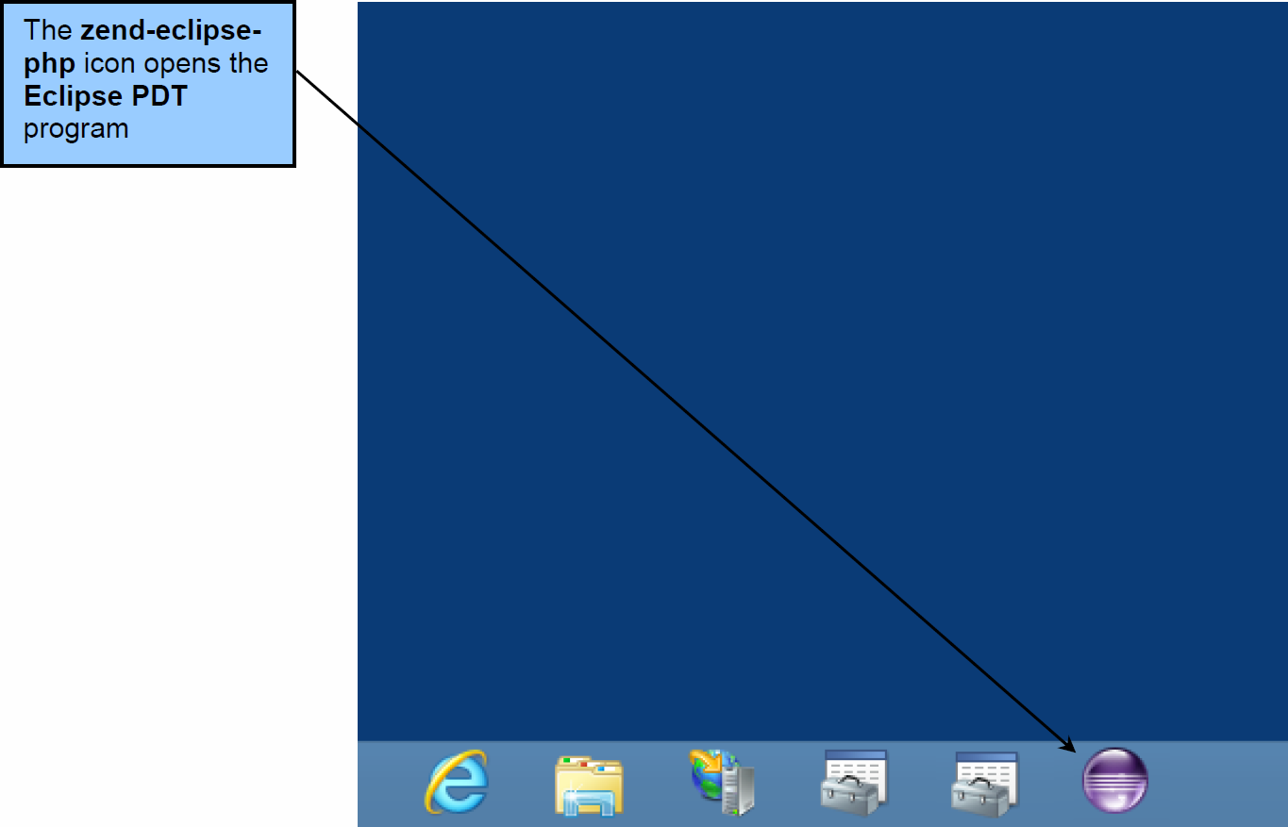
Installing the Eclipse PDT The Zend Eclipse PDT Icon on the Windows Start Menu

Slide 39
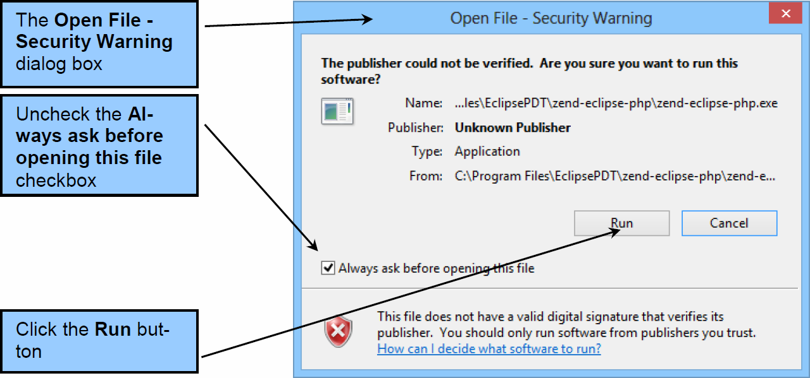
Installing the Eclipse PDT The Open File – Security Warning Dialog Box

Slide 40

Installing the Eclipse PDT The Eclipse Splash Screen

Slide 41
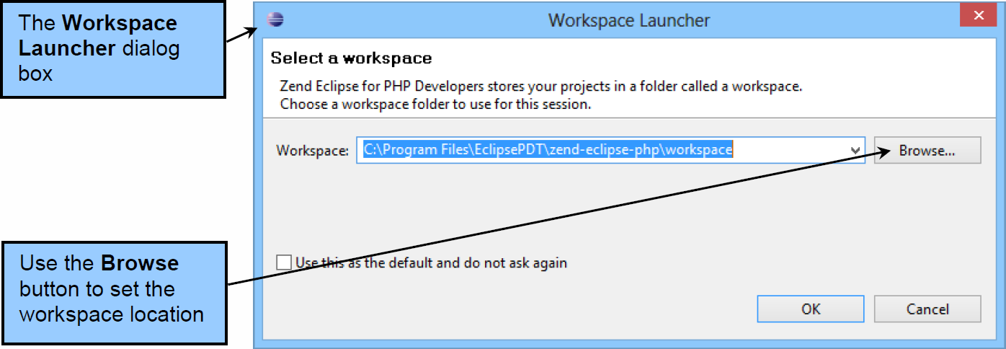
Installing the Eclipse PDT The Workspace Launcher Dialog Box

Slide 42
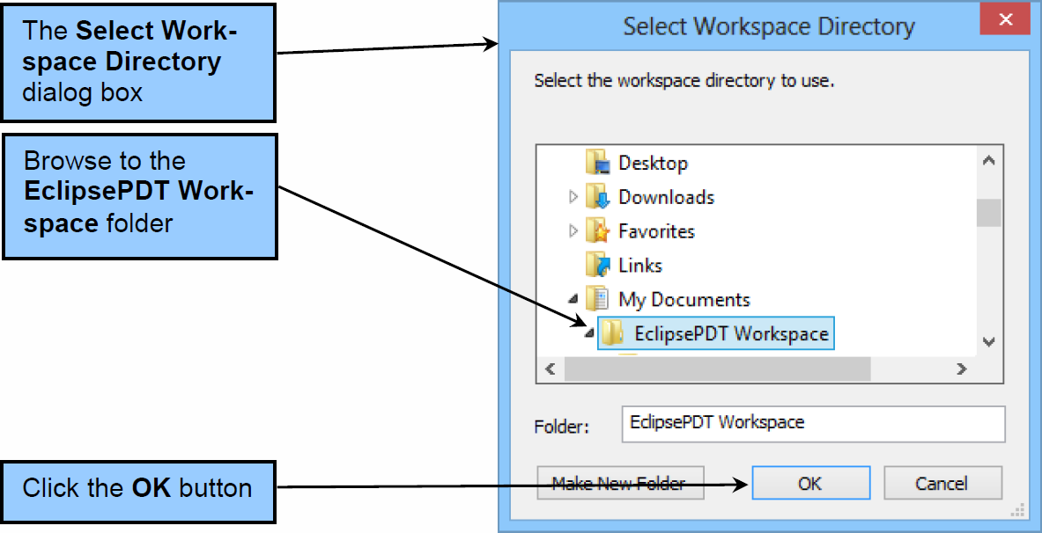
Installing the Eclipse PDT The Select Workspace Directory Dialog Box

Slide 43
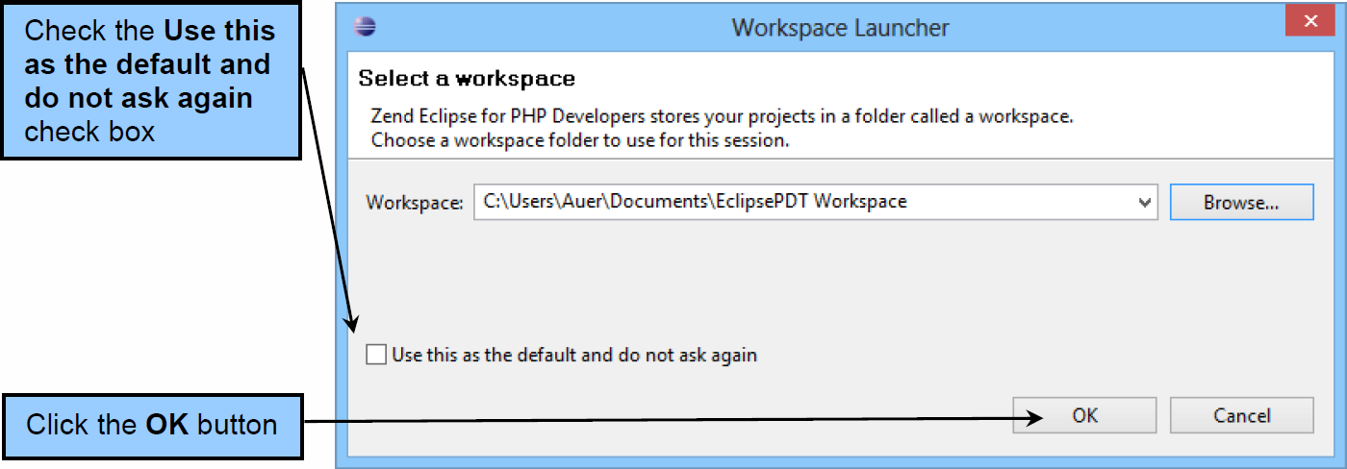
Installing the Eclipse PDT The Workspace Launcher Dialog Box

Slide 44
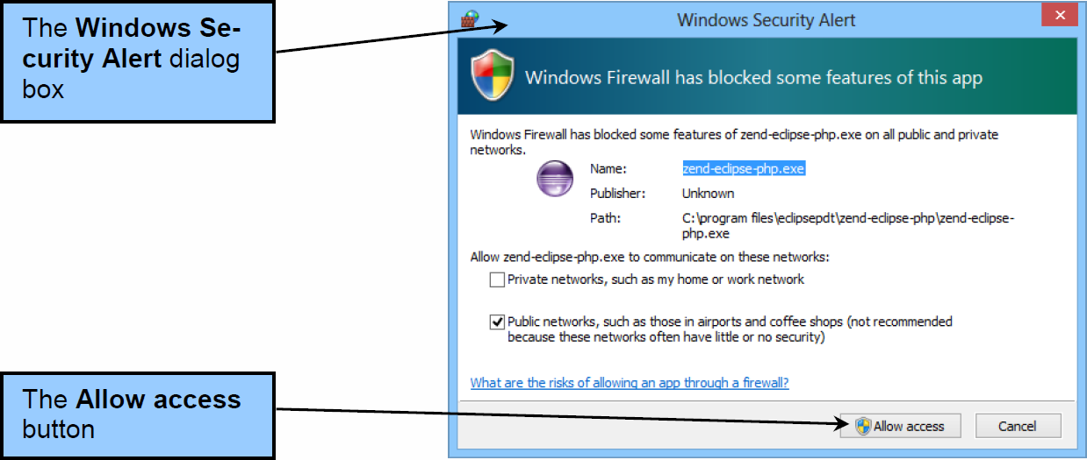
Installing the Eclipse PDT The Windows Security Alert Dialog Box

Slide 45
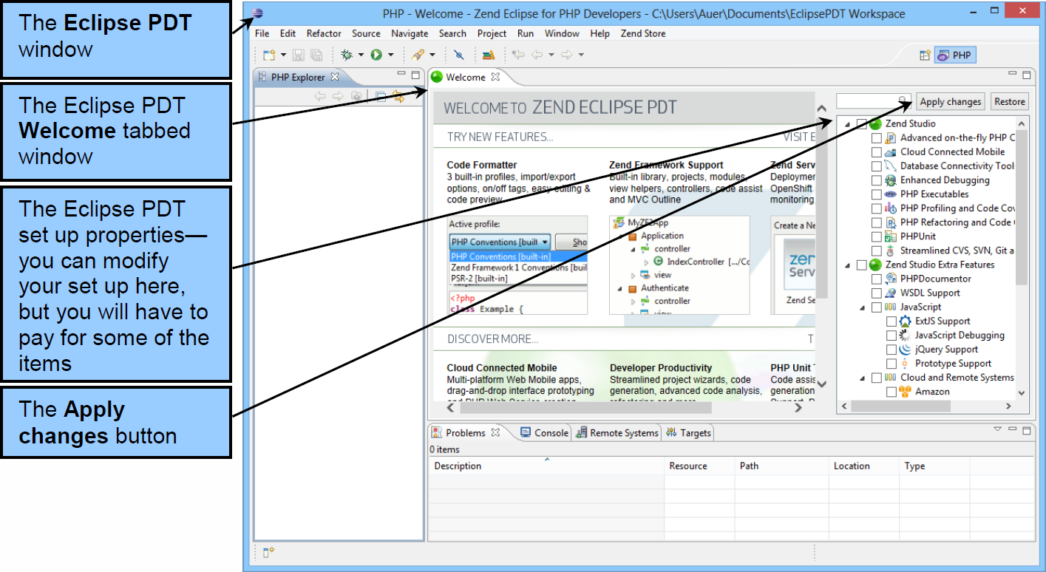
Installing the Eclipse PDT The PHP – Zend Eclipse Window

Slide 46
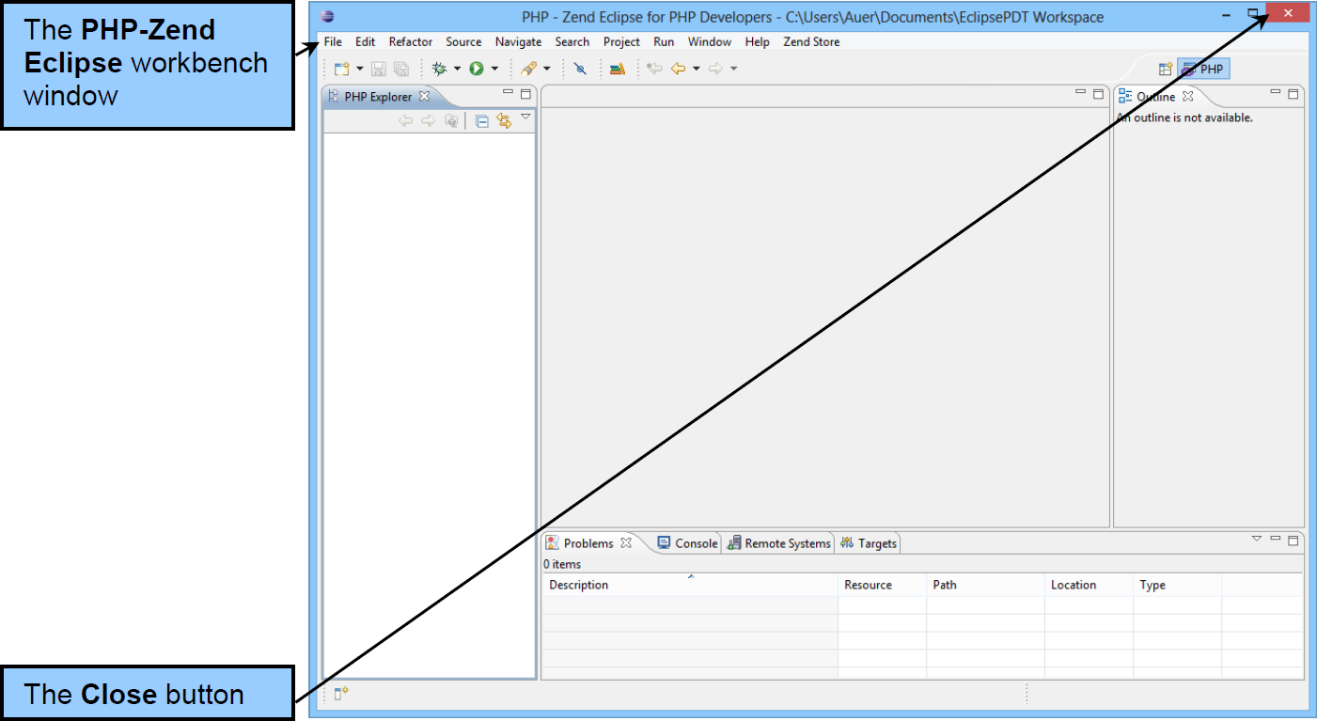
Installing the Eclipse PDT The PHP – Zend Eclipse Workbench Window

Slide 47
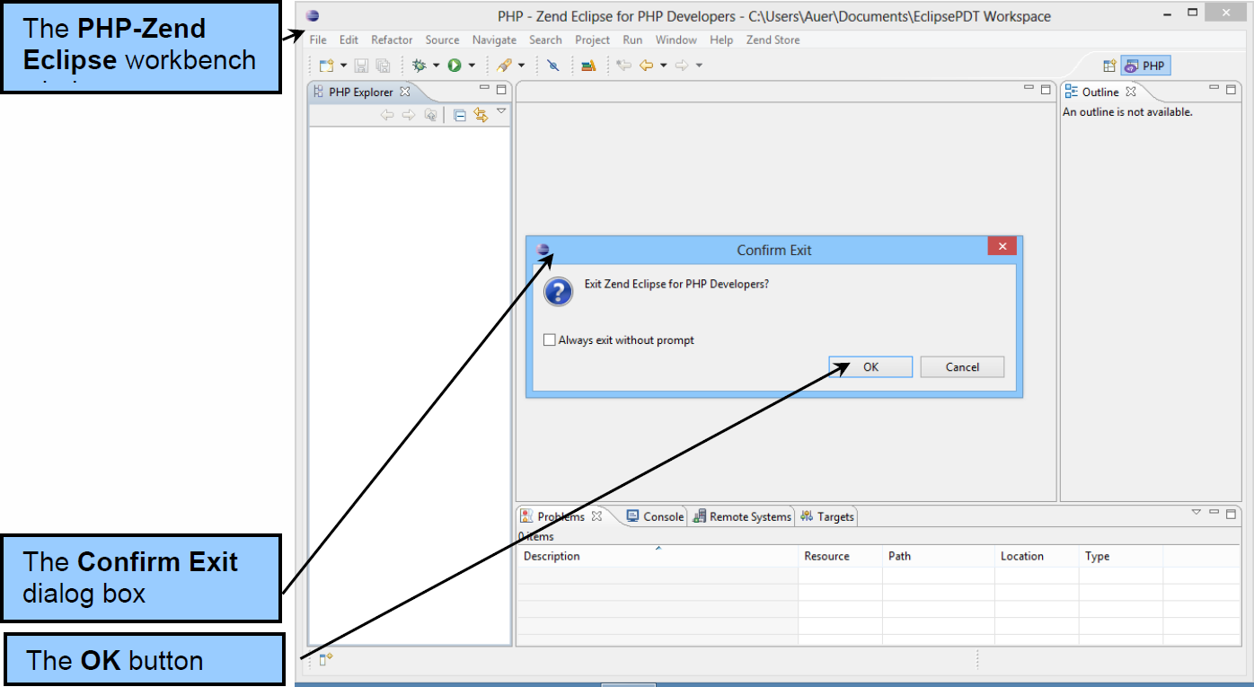
Installing the Eclipse PDT Exiting the PHP – Zend Eclipse PDT

Slide 48
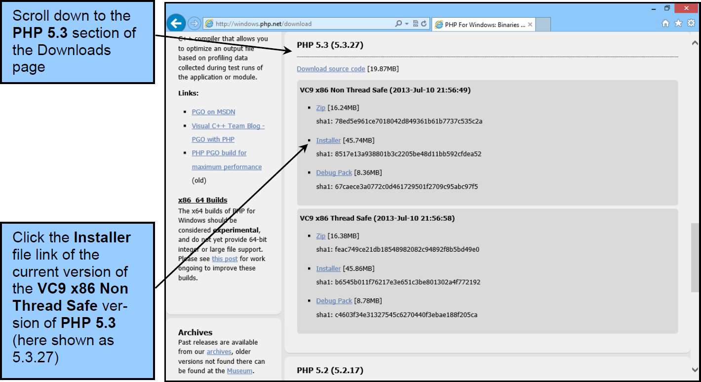
Installing PHP Downloading PHP

Slide 49
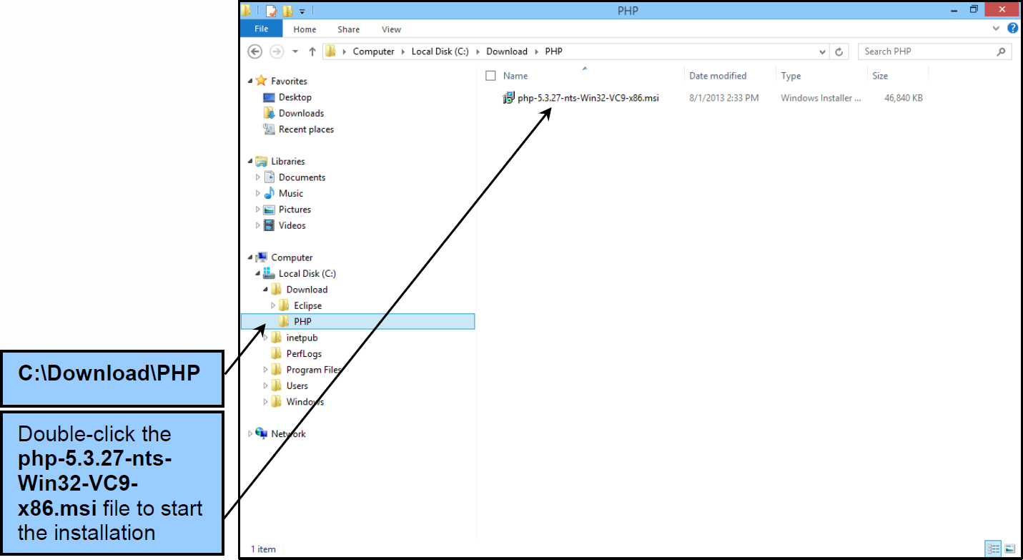
Installing PHP Starting the PHP Installation

Slide 50
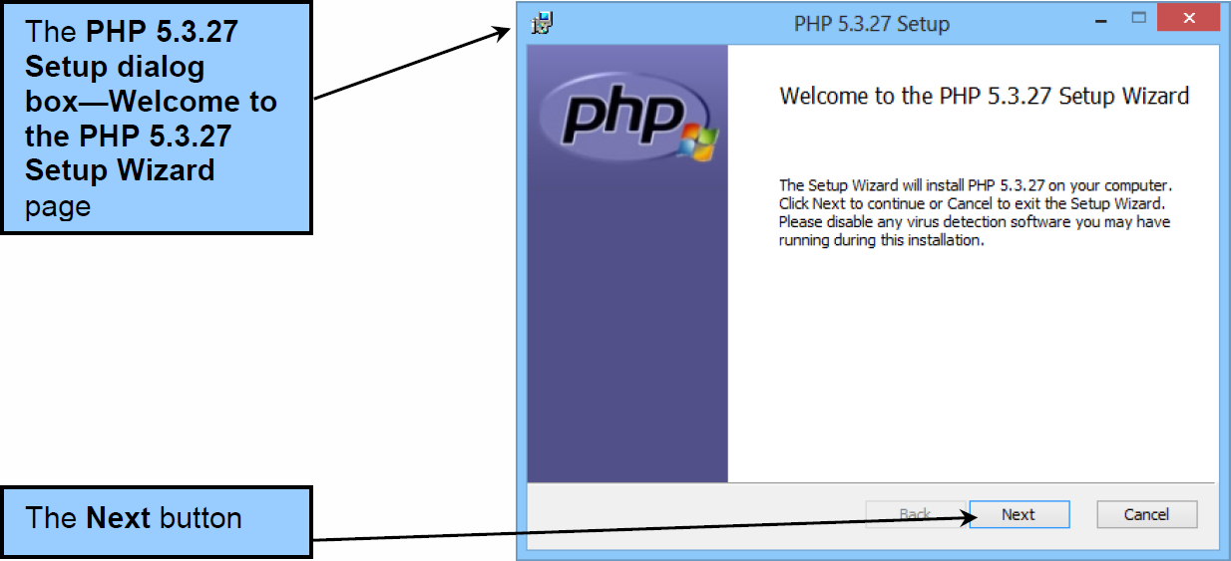
Installing PHP The PHP 5.3.27 Setup Wizard

Slide 51
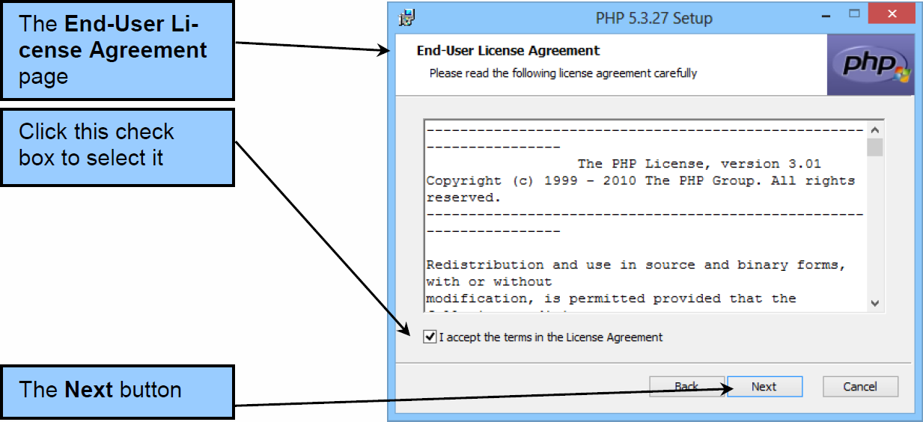
Installing PHP The End-User Agreement

Slide 52
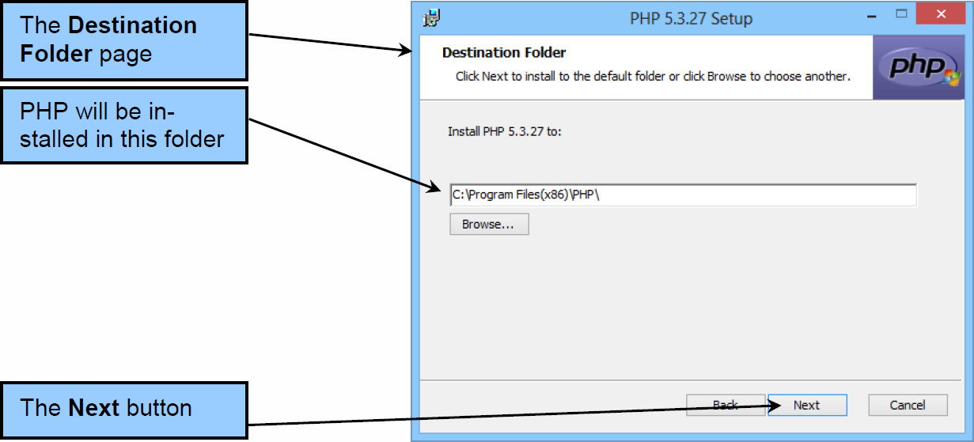
Installing PHP The Destination Folder Page

Slide 53

Installing PHP The Web Server Setup Page

Slide 54

Installing PHP The Choose Items to Install Page

Slide 55

Installing PHP The Installing PHP 5.3.27 Page

Slide 56

Installing PHP The User Account Control Dialog Box

Slide 57

Installing PHP The Completed the PHP 5.3.27 Setup Wizard Page

Slide 58

Testing PHP The File | New | Local PHP Project Command

Slide 59

Testing PHP The Local PHP Project Dialog Box—Create a Local PHP Project Page

Slide 60


Testing PHP The New Local PHP Project Dialog Box— New PHP Project Page

Slide 61

Testing PHP The New Local PHP Project Dialog Box—Library Configuration Page

Slide 62

Testing PHP The DBP-e13-PHP-Test Project

Slide 63

Testing PHP The File | New | PHP File Command

Slide 64

Testing PHP The New PHP File Dialog Box—New PHP File Page

Slide 65

Testing PHP The New PHP File Dialog Box—Select PHP Template Page

Slide 66

Testing PHP The phptest.php Web page code

Slide 67

Testing PHP The phptest.php PHP code

Slide 68


Testing PHP Expanding the DBP-e13-PHP-Test Project Structure

Slide 69

Testing PHP The Short-cut Menu

Slide 70

Testing PHP The Export Dialog Box—Select Page

Slide 71

Testing PHP The Select Page—File System Export Destination

Slide 72

Testing PHP The Export Dialog Box—File System Page

Slide 73

Testing PHP The Export to Directory Dialog Box

Slide 74

Testing PHP The Export Dialog Box—Completed Settings

Slide 75

Testing PHP The PHP Information Page in the Web Browser

Slide 76
Managing the PHP Configuration PHP Dynamic Extension *.dll Files
The Windows Installer installation installs and enables a limited set of the PHP dynamic extension *.dll files that PHP uses to extend PHP functionality to various DBMS products. *.dll files are Microsoft dynamic linked library files, which provide the ability to share program capabilities and functionalities between programs by letting each of the programs use a common *.dll file.

Slide 77

Managing the PHP Configuration The PHP *.dll Files Installed by the Windows Installer for PHP

Slide 78
Managing the PHP Configuration Adding Needed PHP Dynamic Extension *.dll Files
The full set of the PHP dynamic extension *.dll files can be obtained by downloading the PHP *.zip file used for manual installation.
Unzip the file in a location other than the PHP directory.
Copy the needed *.dll files to ..\PHP\ext.
Update the php.ini file.
Reboot the computer.

Slide 79

Modifying the PHP Installation The Full Set of PHP *.dll Files

Slide 80

Modifying the PHP Installation The Dynamic Extensions in the php.ini Configuration File

Slide 81
Managing the PHP Configuration Installing the Microsoft Drivers 3.0 for PHP for SQL Server
Download the installation file from http://www.microsoft.com/en-us/download/details.aspx?id=20098.
The installation is actually a file that expands a zipped set of files when run.
Run the installation file.

Slide 82

Modifying the PHP Installation The Dynamic Extension and Help Files

Slide 83
Managing the PHP Configuration Installing the Microsoft Drivers 3.0 for PHP for SQL Server
Copy the needed *.dll files to ..\PHP\ext.
extension=php_sqlsrv_53_nts.dll
extension=php_pdo_sqlsrv_53_nts.dll
Update the php.ini file.
Reboot the computer.

Slide 84

Modifying the PHP Installation Opening the php.ini File in Microsoft Notepad

Slide 85

Modifying the PHP Installation The Added Configuration Files in php.ini

Slide 86
Managing the PHP Configuration Using the Microsoft Drivers 3.0 for PHP for SQL Server
To use the SQL Server drivers instead of the OBDC drivers, modify the Web page php code.
Instead of:
// Execute SQL statement
$RecordSet = odbc_exec($Conn,$SQL);
Use:
// Execute SQL statement
$RecordSet = sqlsrv_query($Conn,$SQL);

Slide 87
David Kroenke and David Auer Database Processing Fundamentals, Design, and Implementation (13th Edition)
End of Presentation:
Appendix I

Slide 88

All rights reserved. No part of this publication may be reproduced, stored in a retrieval system, or transmitted, in any form or by any means, electronic, mechanical, photocopying, recording, or otherwise, without the prior written permission of the publisher. Printed in the United States of America.

